Slide 1
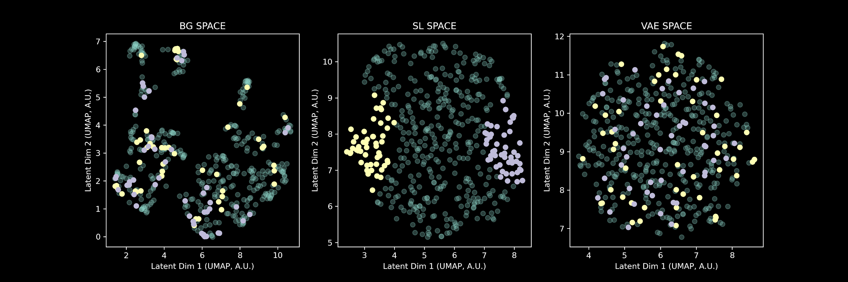
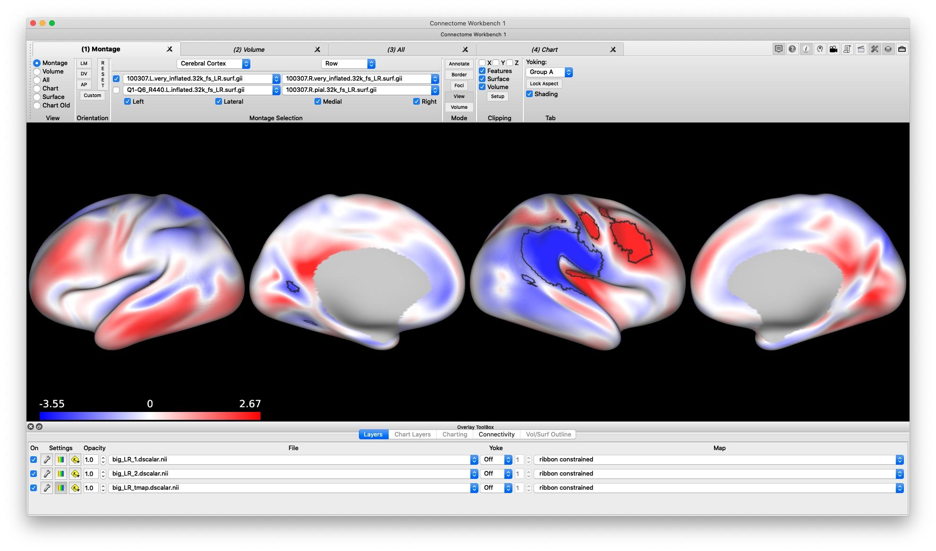
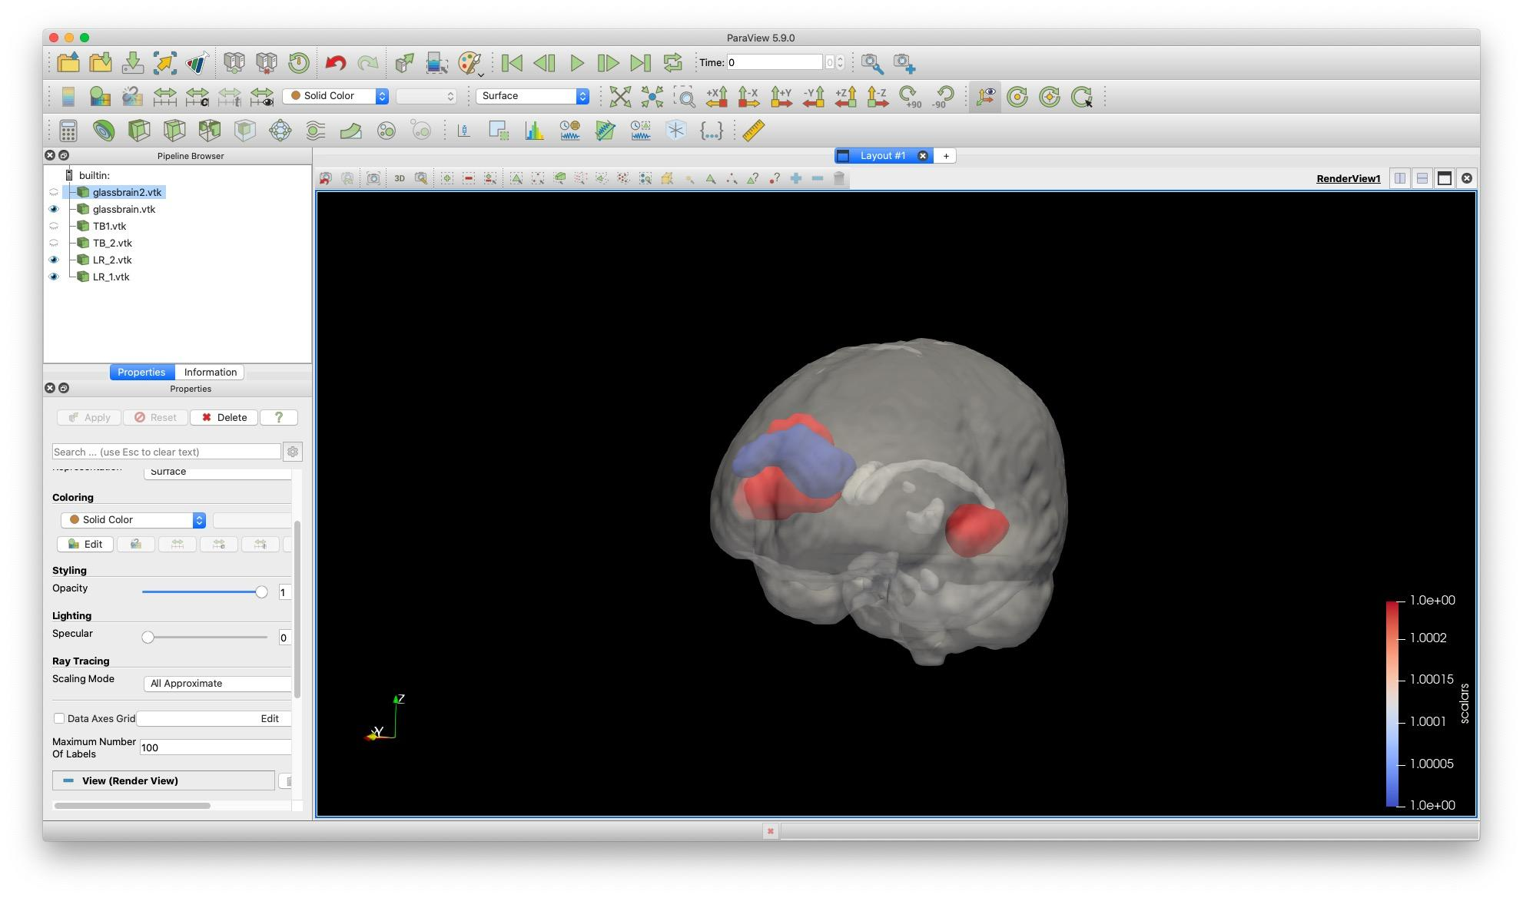
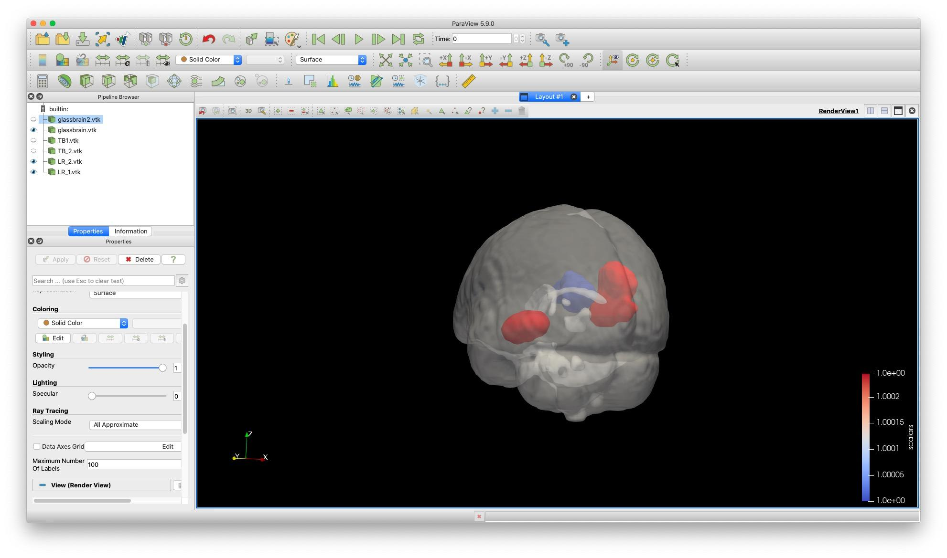
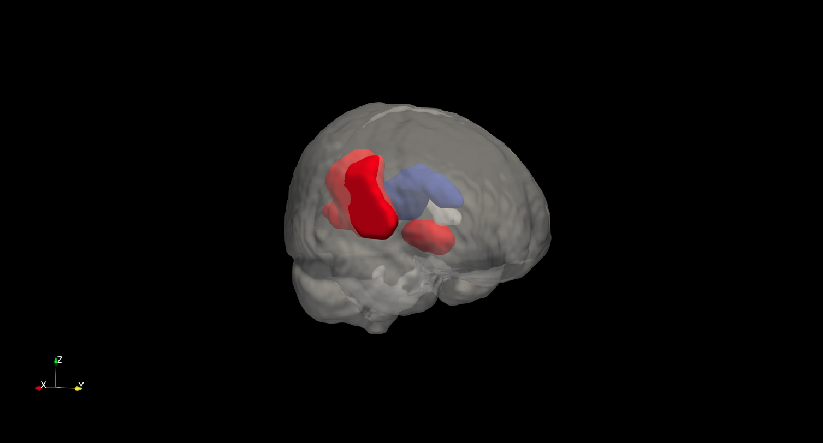
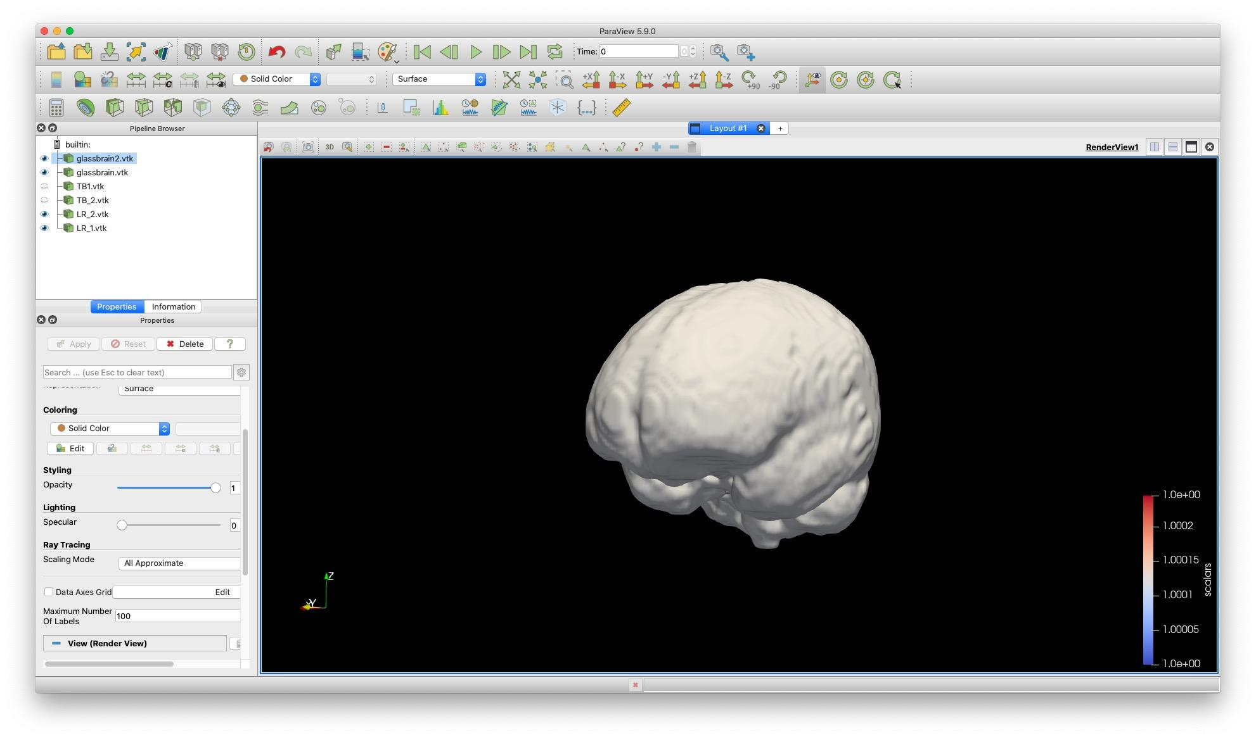
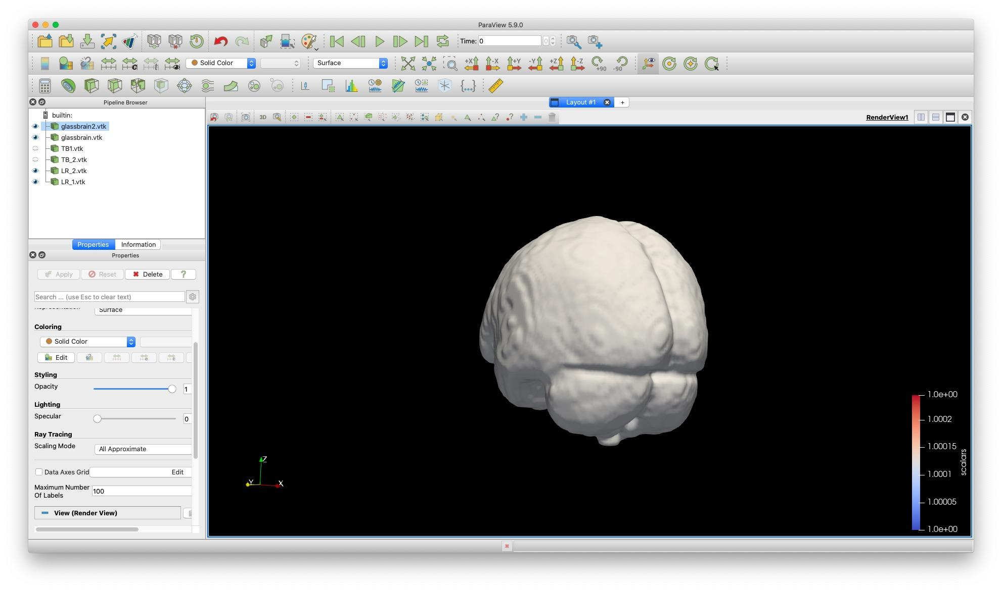
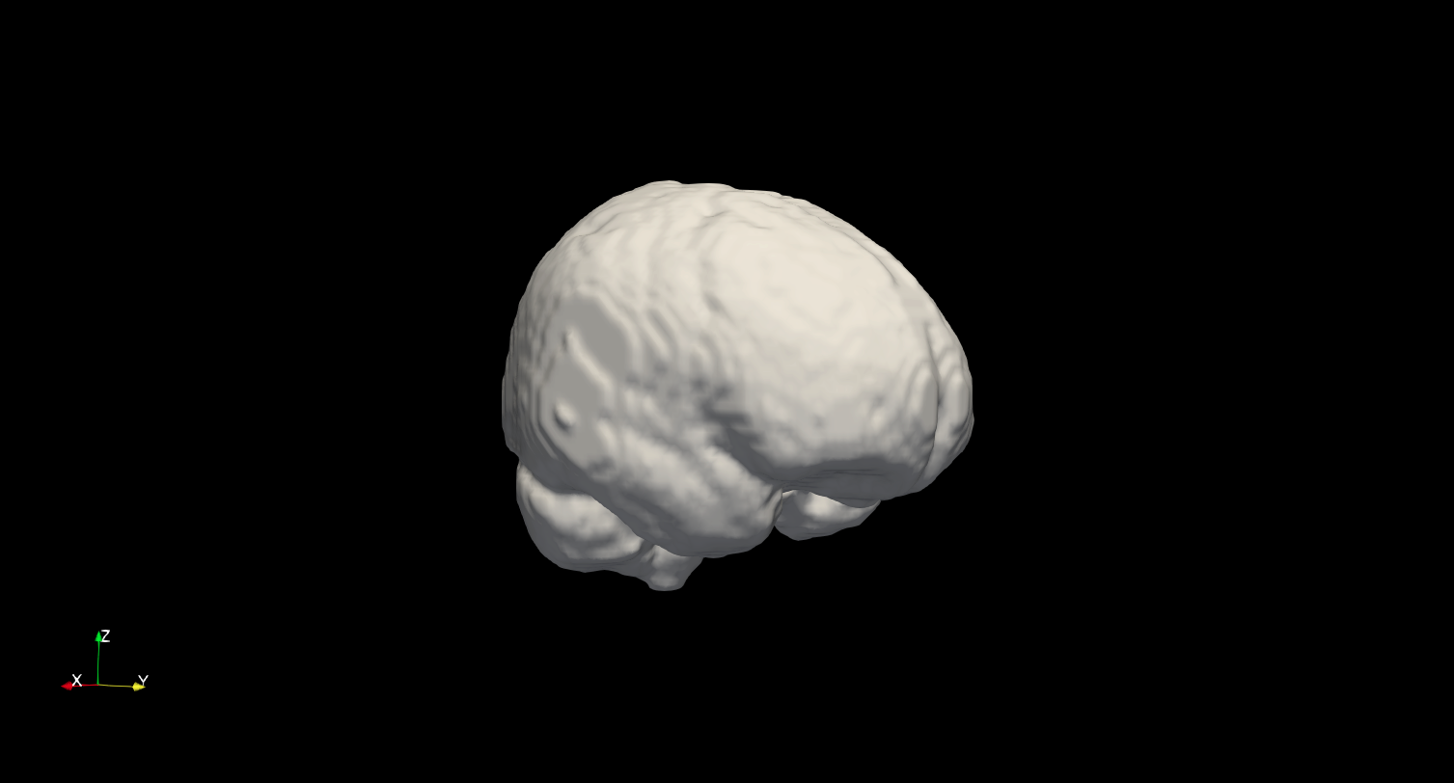
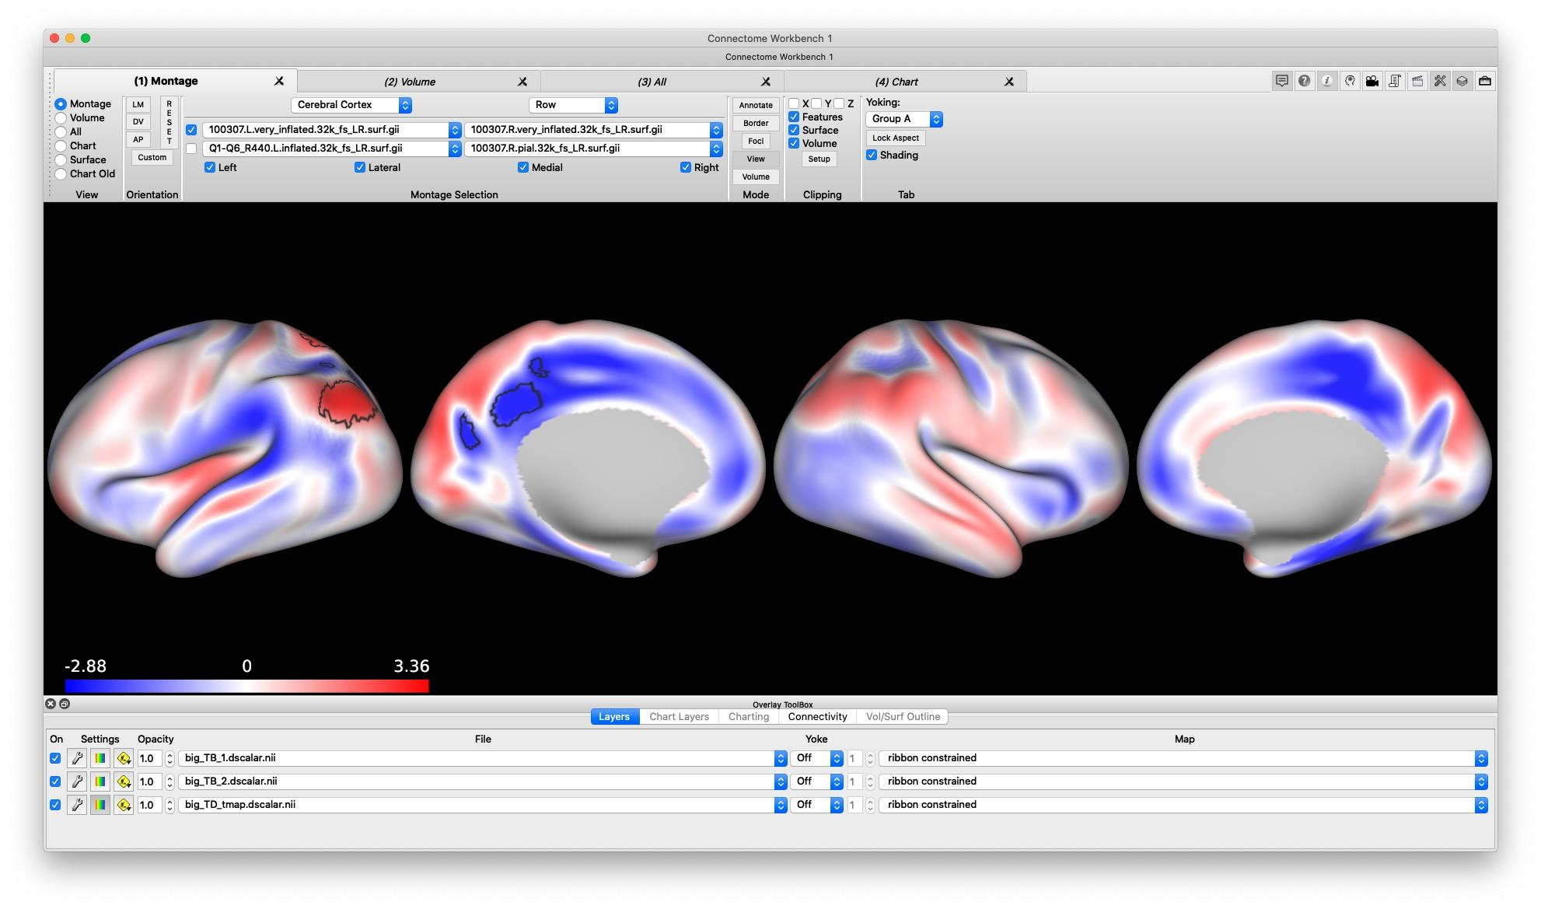

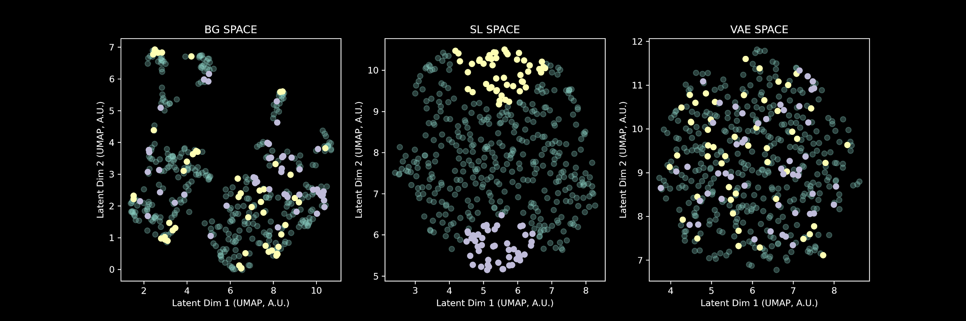
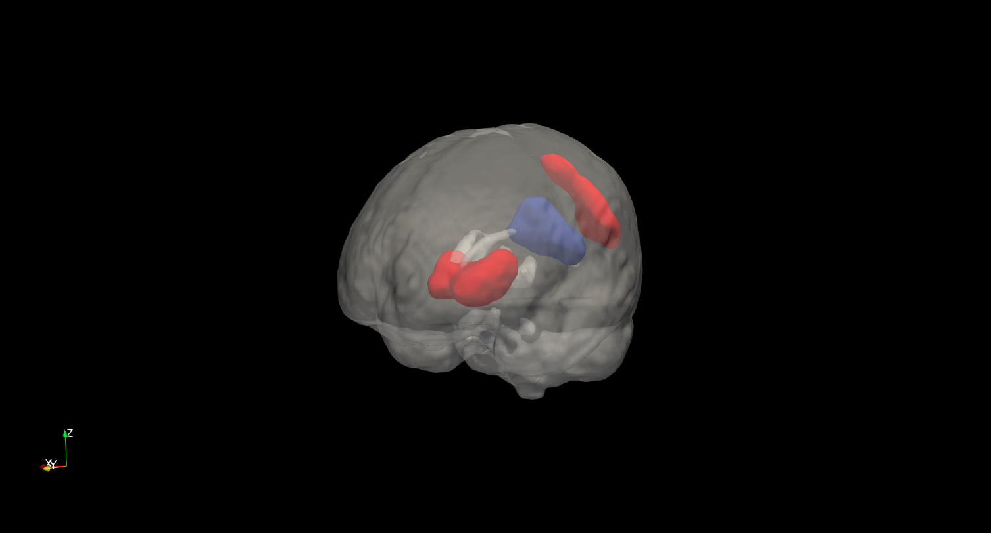
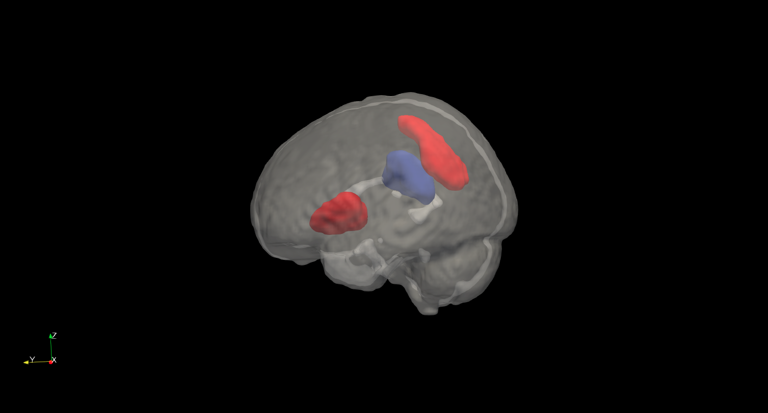
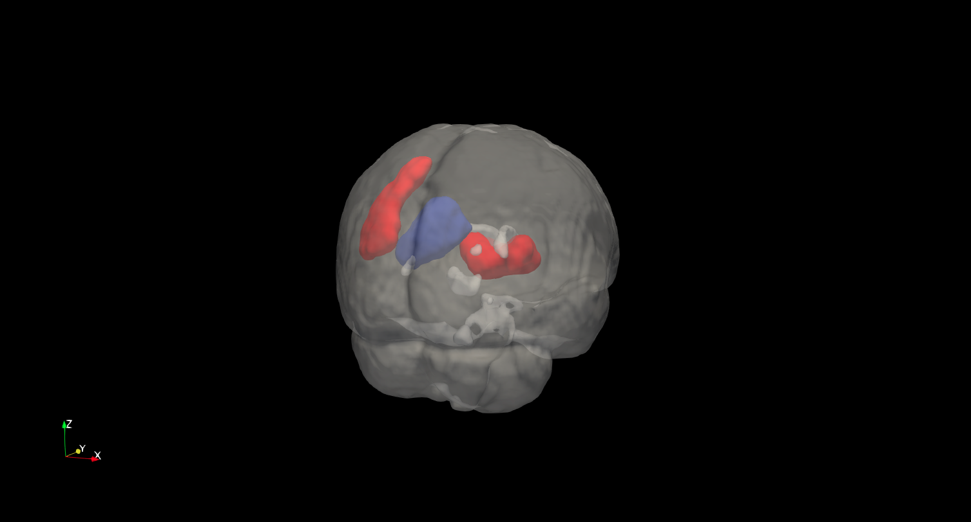
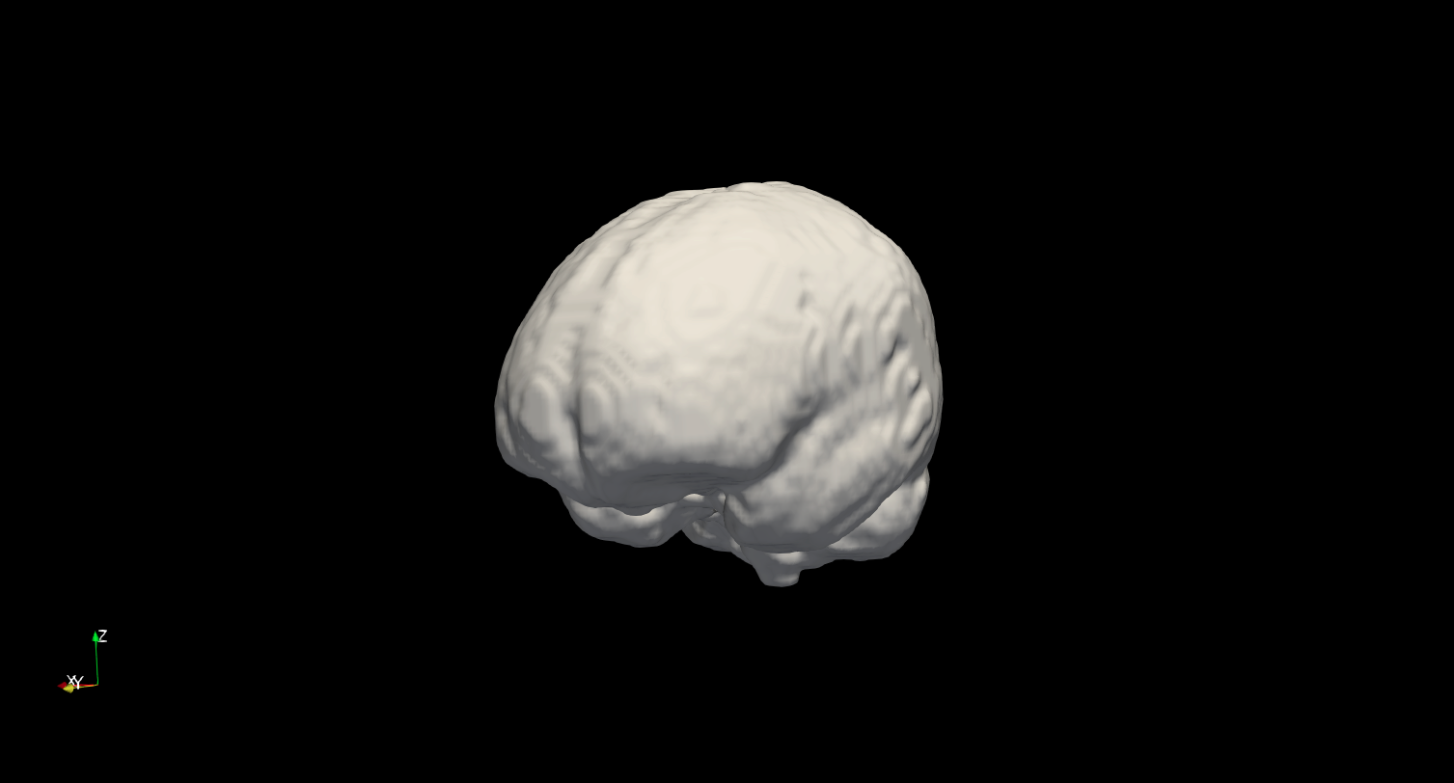
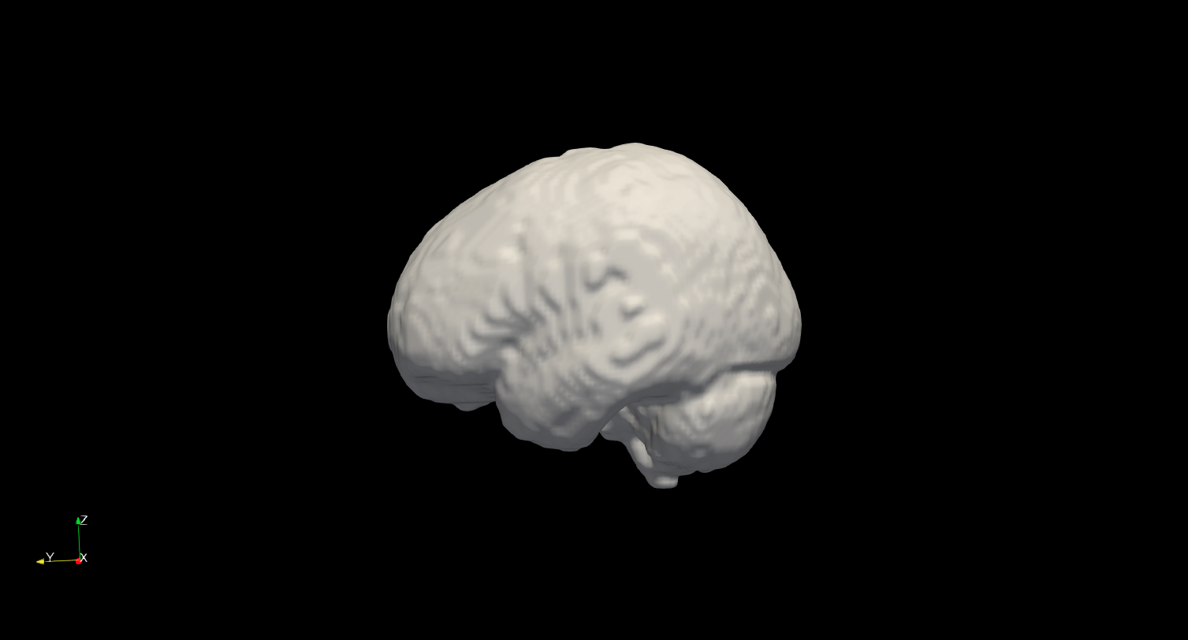
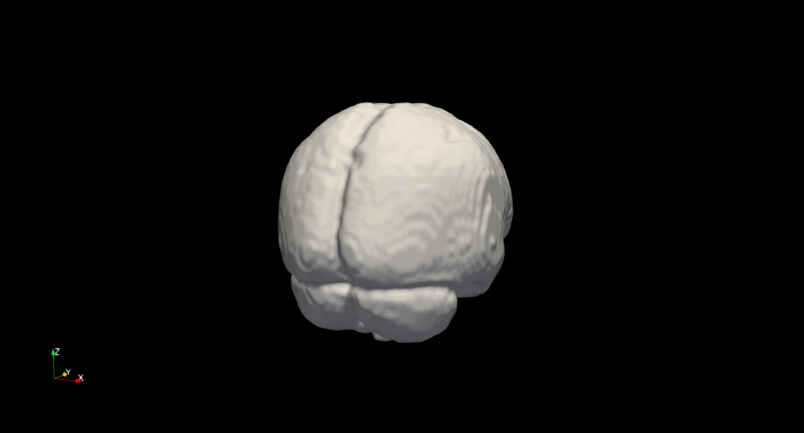
t-comparison Axis
Cortical View
Volumetric View
Expansion / compression. Cluster p < .05 (FWE)
Left vs Right
-4.66
t-value
4.2
Orientation guide
0
Cluster p < .05 (FWE)
Top vs Bottom
Expansion / compression. Cluster p < .05 (FWE)
t-value
4.74
Cluster p < .05 (FWE)
Orientation guide
-3.65
0
0

Slide 2
t-comparison Axis
Cortical View
Volumetric View
Expansion / compression. Cluster p < .05 (FWE)
-4.66
t-value
4.2
Orientation guide
0
Cluster p < .05 (FWE)
Expansion / compression. Cluster p < .05 (FWE)
t-value
4.74
Cluster p < .05 (FWE)
Orientation guide
-3.65
0
0

Slide 3
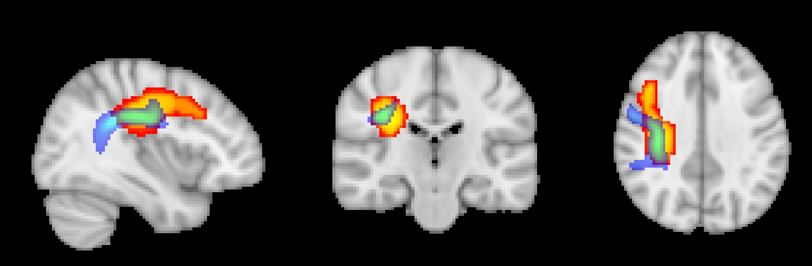
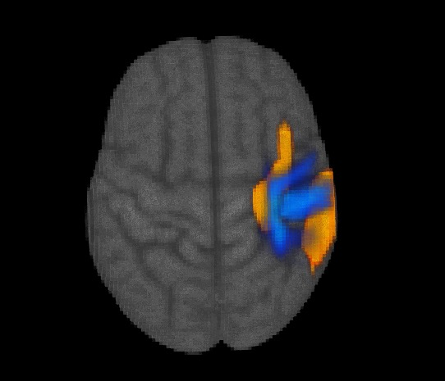
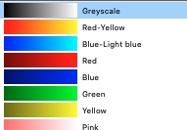
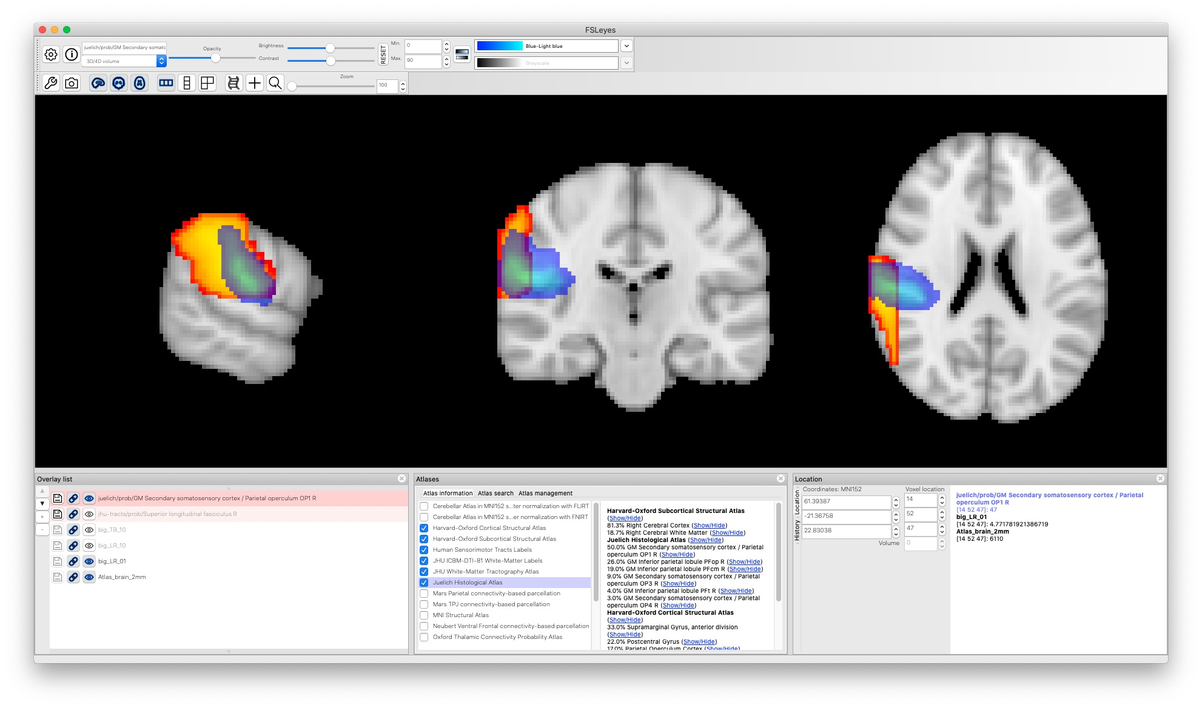
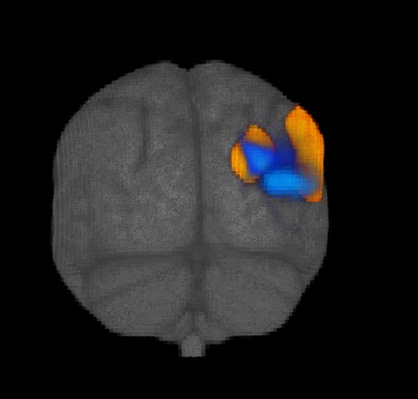
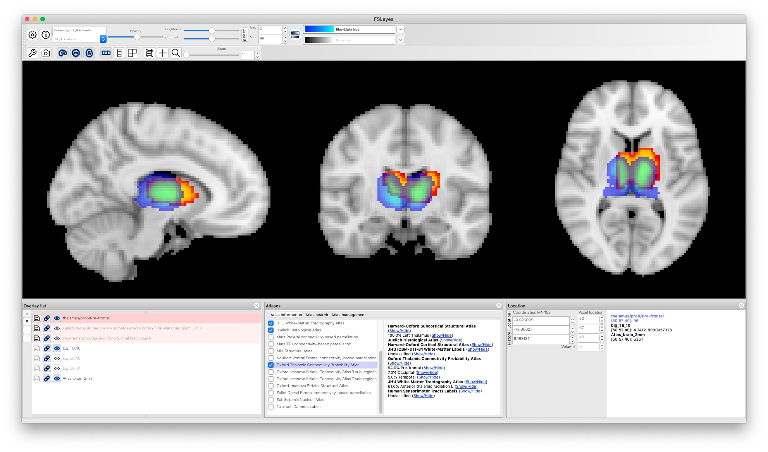
Left vs Right
Left > Right
low
SLF.
t-value
Cluster p < .05 (FWE)
high
3.2
4.7
prob.
Right > Left
SII
t-value
Cluster p < .05 (FWE)
low
high
3.2
4.9
Top vs Bottom
prob.
Top > Bottom
Thalamus
t-value
Cluster p < .05 (FWE)
low
high
3.2
4.7
prob.

